Slide 1

Nessus
Network Vulnerability Scanner

Slide 2
Introduction
Nessus is a widely-used vulnerability assessment tool that helps organizations identify and prioritize security vulnerabilities within their IT infrastructure. With its extensive capabilities and user-friendly interface, Nessus plays a crucial role in strengthening cyber security defenses and reducing the risk of data breaches and cyberattacks.

Slide 3
Introduction
Founded by Renuad Deraison in 1998 to offer a free remote security scanner.
Functions as a vulnerability scanner to detect system weaknesses.
Supports multiple operating systems: Windows, Linux, and Mac.
Uses a web interface for installation, scanning, and reporting.
Identifies vulnerabilities that enable remote attackers to access sensitive data.

Slide 4
Problem Statement
Organizations face numerous challenges in managing and mitigating security vulnerabilities, including: Identifying vulnerabilities across a diverse and dynamic IT environment, including servers, endpoints, and network devices. Prioritizing remediation efforts based on the severity and potential impact of vulnerabilities. Demonstrating compliance with regulatory requirements and industry standards such as PCI DSS, HIPAA, and CIS benchmarks.

Slide 5
Hardware Requirement
Hardware Requirements for Nessus
Up to 50,000 hosts:
CPU: 1 dual-core 2 GHz
RAM: 2 GB (4 GB recommended)
Disk: 30 GB
Over 50,000 hosts:
CPU: 1 dual-core 2 GHz (2 dual-core recommended)
RAM: 2 GB (8 GB recommended)
Disk: 30 GB (more space may be needed for reports)

Slide 6
Download & Installation
Download Nessus Professional from https://www.tenable.com/products/nessus/nessus-professional
Register at https://www.tenable.com/products/nessus/activation-code
Install the Nessus tool
Open Nessus in your browser at http://localhost:8834/WelcomeToNessus-Install/welcome
Create an account and enter the activation code
Download necessary plugins
After installation, log in with your credentials on the redirected login page

Slide 7
Key Functions
Network Scanning
Malware Detection
Mobile Security
Host Discovery
Policy Review
DROWN Detection
PCI External Scan

Slide 8
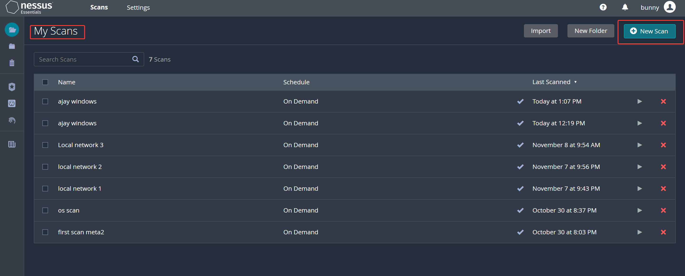
Scanning Process
Click on new scan to start the vulnerability scan.

Slide 9
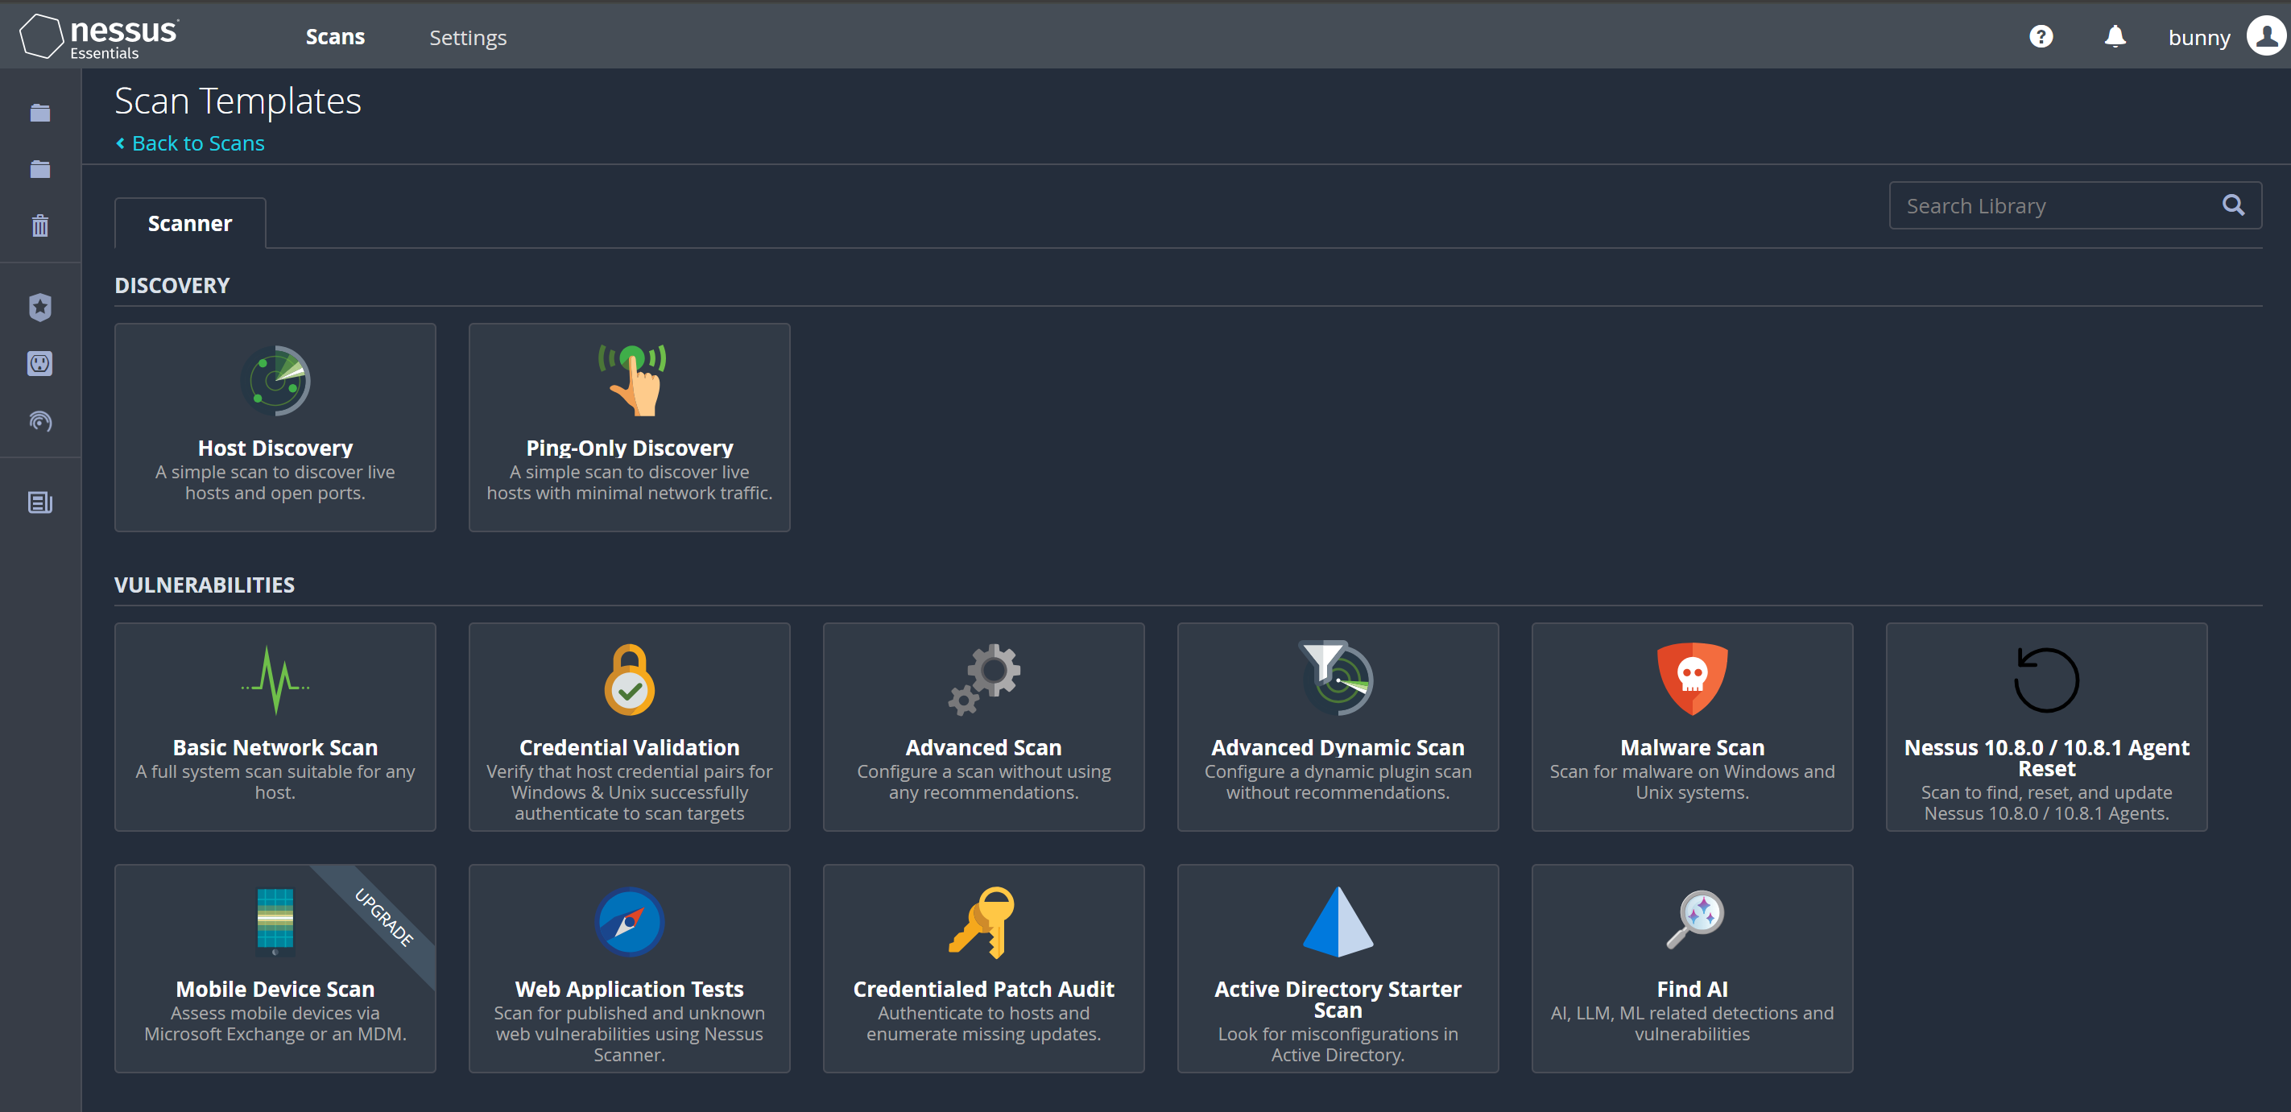
Nessus Templates
Select the type of network scan to perform.

Slide 10
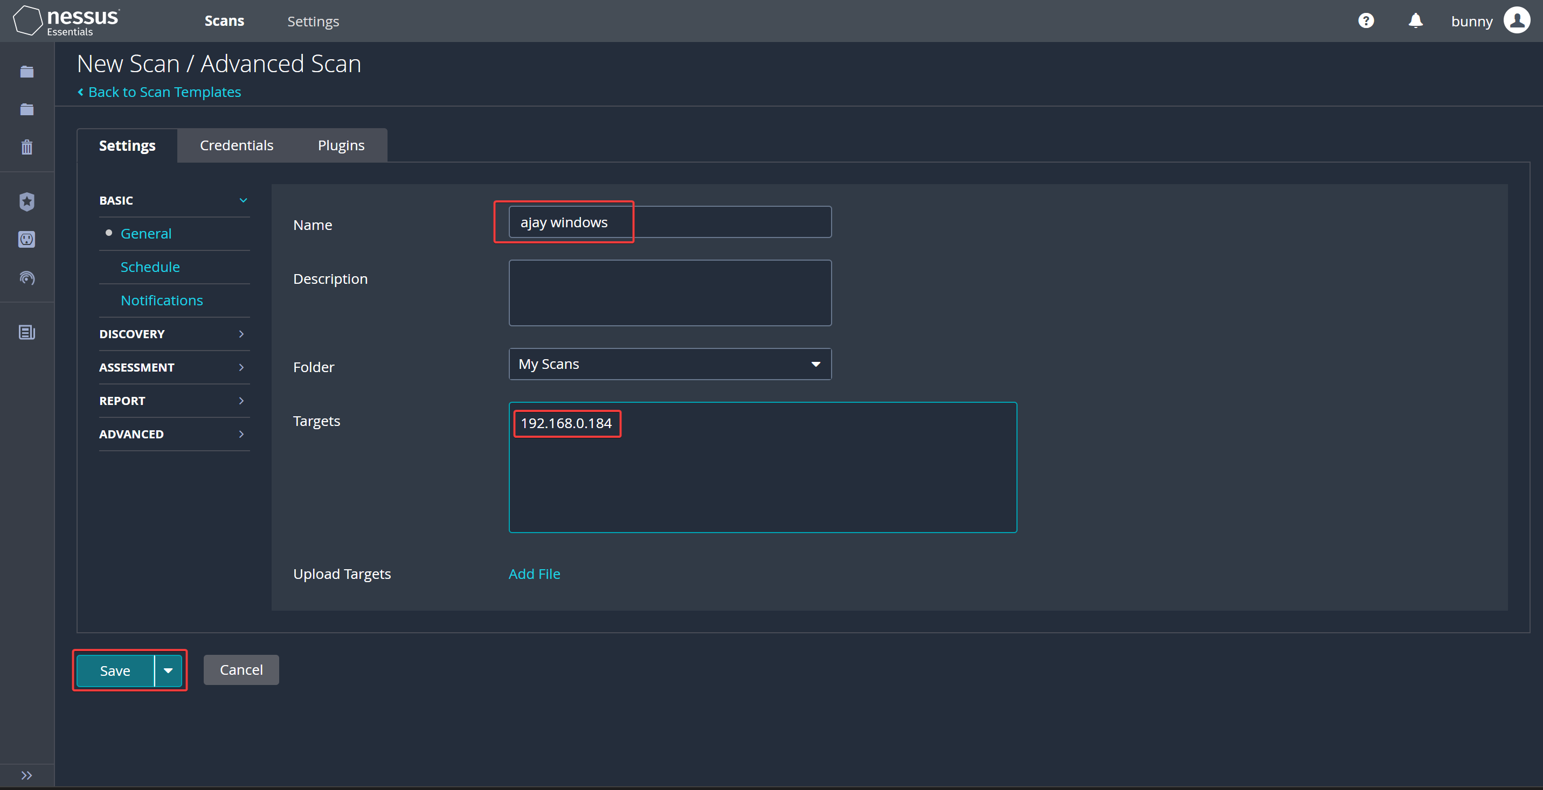
Network Scanning
Name your scan, add a description, enter IP addresses, and launch the scan.

Slide 11
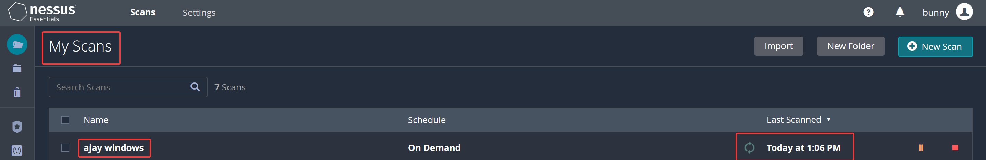
Scanning Process
The scan is currently running and will take some time as it thoroughly checks all vulnerabilities in
the network IP address.

Slide 12
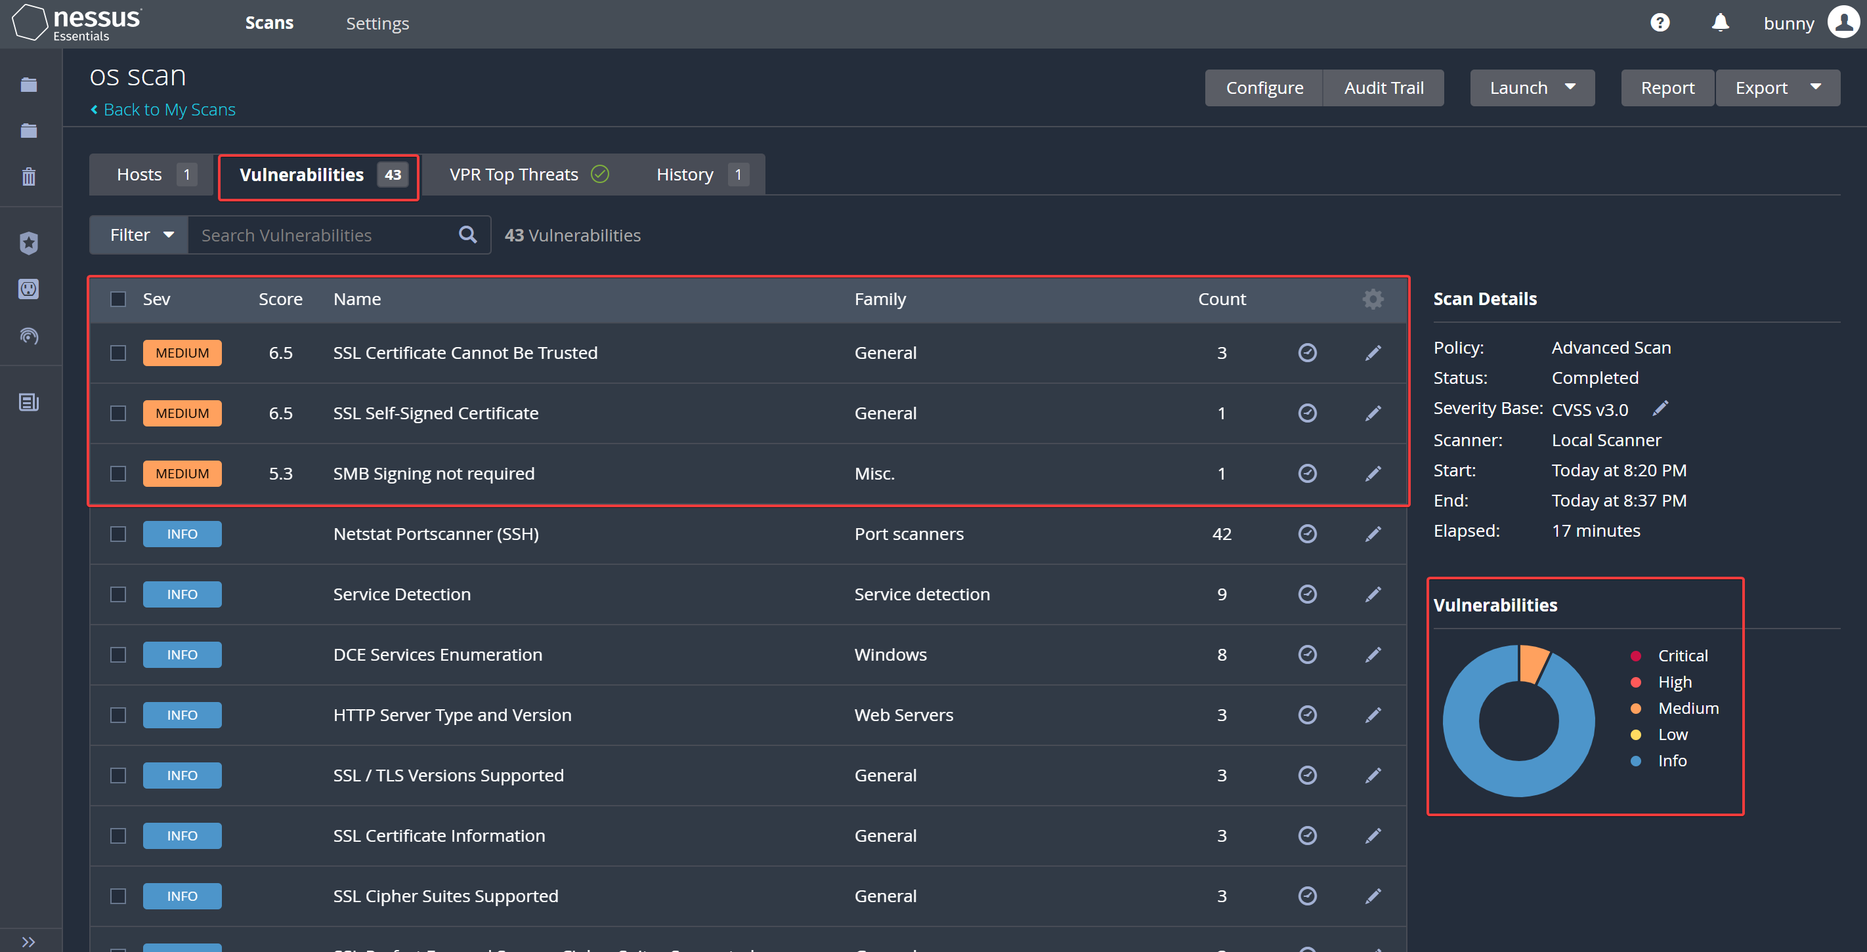
Result
View the pie chart and then proceed to the vulnerabilities section.

Slide 13
Advantages
Highly accurate scanning with minimal false positives.
Comprehensive scanning features.
Scalable to hundreds of thousands of systems.
Easy to deploy and maintain.
Low administration and operation costs.
Full coverage with agents, including laptops and mobile devices.

Slide 14
Solution Overview
Nessus addresses these challenges by providing: Comprehensive vulnerability scanning capabilities, including active and passive scanning techniques, to identify known and emerging threats. Prioritization of vulnerabilities based on severity, exploitability, and potential impact, enabling organizations to focus on addressing the most critical risks first. Integration with third-party tools and platforms for automated remediation, workflow orchestration, and reporting.

Slide 15
Key Features and Benefits
Vulnerability Detection: Nessus scans IT assets for known vulnerabilities, misconfigurations, and security weaknesses, providing organizations with actionable insights into their security posture.
Compliance Auditing: The tool supports compliance auditing against a wide range of regulatory standards and industry best practices, facilitating compliance efforts and regulatory reporting.
Risk Prioritization: Nessus categorizes vulnerabilities based on their severity and potential impact on the organization, allowing security teams to prioritize remediation efforts effectively.

Slide 16
Key Features and Benefits
Scalability: With support for distributed scanning and centralized management, Nessus scales to meet the needs of organizations of all sizes, from small businesses to large enterprises.
Integration: Nessus integrates with security information and event management (SIEM) systems, ticketing systems, and other security tools, enabling seamless workflow integration and automation.

Slide 17
Use Cases
Vulnerability Management: Nessus is essential for organizations seeking to proactively manage and mitigate security vulnerabilities across their IT infrastructure, reducing the risk of exploitation and data breaches.
Penetration Testing: As part of a comprehensive security testing program, Nessus can be used to identify potential entry points for attackers and validate the effectiveness of security controls.
Compliance Reporting: Nessus generates detailed reports highlighting compliance status, gaps, and recommendations for remediation, supporting regulatory compliance efforts and audit requirements.
Asset Discovery: Nessus helps organizations discover and inventory IT assets within their environment, providing visibility into potential blind spots and shadow IT infrastructure.

Slide 18
Return on Investment (ROI)
Risk Reduction: By identifying and remediating vulnerabilities proactively, Nessus helps organizations minimize the likelihood and impact of security breaches, reducing the associated financial and reputational risks.
Operational Efficiency: The automation capabilities of Nessus streamline the vulnerability management process, enabling security teams to assess, prioritize, and remediate vulnerabilities more efficiently, thereby reducing operational overhead and costs.
Compliance Assurance: Nessus assists organizations in maintaining compliance with regulatory requirements and industry standards, avoiding non-compliance penalties and fines.

Slide 19
Conclusion
In conclusion, Nessus is a valuable asset for organizations committed to maintaining a strong security posture and protecting their IT infrastructure from cyber threats. By providing comprehensive vulnerability assessment capabilities, risk prioritization, and compliance auditing features, Nessus empowers organizations to identify, manage, and mitigate security vulnerabilities effectively. Investing in Nessus is not just an expenditure but a strategic decision to enhance cyber resilience, safeguard sensitive data, and maintain stakeholder trust in an increasingly hostile cyber landscape.

Slide 20
THANK YOU

